Slide 1
Module 1: Basics of NLP
By
Ms. Sarika Dharangaonkar
Assistant Professor,
KJSCE

Slide 2
What is NLP?
NLP stands for Natural Language Processing, which is a part of Computer Science, Human language, and Artificial Intelligence.
It is the technology that is used by machines to understand, analyse, manipulate, and interpret human's languages.
It helps developers to organize knowledge for performing tasks such as translation, automatic summarization, Named Entity Recognition (NER), speech recognition, relationship extraction, and topic segmentation.

Slide 3
Advantages of NLP
NLP helps users to ask questions about any subject and get a direct response within seconds.
NLP offers exact answers to the question means it does not offer unnecessary and unwanted information.
NLP helps computers to communicate with humans in their languages.
It is very time efficient.
Most of the companies use NLP to improve the efficiency of documentation processes, accuracy of documentation, and identify the information from large databases.

Slide 4
Disadvantages of NLP
NLP may not show context.
NLP is unpredictable
NLP may require more keystrokes.
NLP is unable to adapt to the new domain, and it has a limited function that's why NLP is built for a single and specific task only.
Notes:
NLP May Not Show Context
Challenge:
NLP systems often struggle to maintain context over a conversation, leading to misunderstandings.
Example:
User: "Where is my order?"
Chatbot: "Can you provide your order number?"
User: "It's 12345."
User (later): "Why is it delayed?"
Chatbot: "Can you provide your order number?"
Explanation:
The chatbot fails to remember the order number provided earlier in the conversation, demonstrating a lack of contextual understanding.
NLP is Unpredictable
Challenge:
NLP systems can produce unpredictable responses, especially when faced with unusual or complex queries.
Example:
User: "I need help with my recent purchase."
Chatbot: "Can you tell me the product name?"
User: "It's a vintage clock."
Chatbot: "Did you mean 'clock'? What kind of clock?"
Explanation:
The chatbot's responses can become erratic or redundant, especially with ambiguous or less common terms like "vintage clock."
NLP May Require More Keystrokes
Interacting with NLP systems can sometimes be heavier/ inconvenient and require more user input than necessary.
example: Conversation in chatbot regarding returning of item.
The conversation involves multiple back-and-forth exchanges, requiring the user to input more information step by step rather than processing a more concise input.
NLP is Unable to Adapt to New Domains
Challenge:
NLP systems are often designed for specific tasks and struggle to adapt to new or unfamiliar domains.
The chatbot is built for handling e-commerce related queries and cannot adapt to requests outside its pre-defined domain, such as finding hiking trails.

Slide 5
Components of NLP
1. Natural Language Understanding (NLU)
Natural Language Understanding (NLU) helps the machine to understand and analyse human language by extracting the metadata from content such as concepts, entities, keywords, emotion, relations, and semantic roles.
NLU mainly used in Business applications to understand the customer's problem in both spoken and written language.
NLU involves the following tasks -
It is used to map the given input into useful representation.
It is used to analyze different aspects of the language.

Slide 6
Components of NLP…
2. Natural Language Generation (NLG)
Natural Language Generation (NLG) acts as a translator that converts the computerized data into natural language representation. It mainly involves Text planning, Sentence planning, and Text Realization.

Slide 7
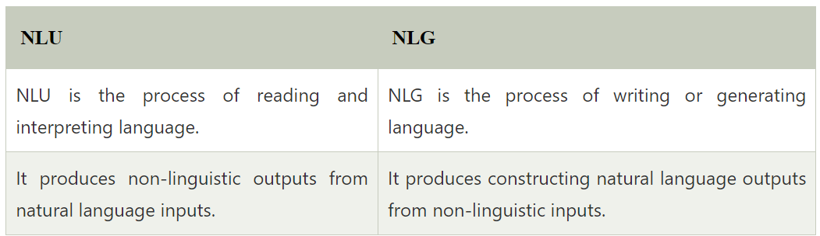
Difference between NLU and NLG

Slide 8

Applications of NLP
1. Question Answering
Question Answering focuses on building systems that automatically answer the questions asked by humans in a natural language.

Slide 9
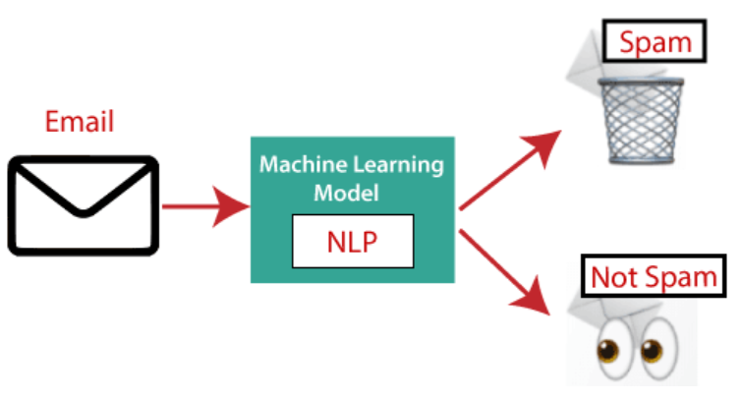
Applications of NLP…
2. Spam Detection
Spam detection is used to detect unwanted e-mails getting to a user's inbox.

Slide 10

Applications of NLP…
3. Sentiment Analysis
Sentiment Analysis is also known as opinion mining. It is used on the web to analyze the attitude, behaviour, and emotional state of the sender. This application is implemented through a combination of NLP (Natural Language Processing) and statistics by assigning the values to the text (positive, negative, or natural), identify the mood of the context (happy, sad, angry, etc.)

Slide 11
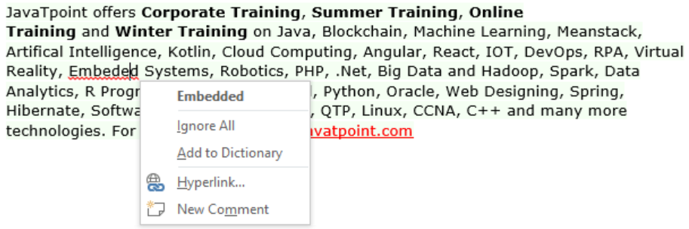
Applications of NLP…
4. Machine Translation
Machine translation is used to translate text or speech from one natural language to another natural language.
Example: Google Translator
5. Spelling correction
Microsoft Corporation provides word processor software like MS-word, PowerPoint for the spelling correction.

Slide 12
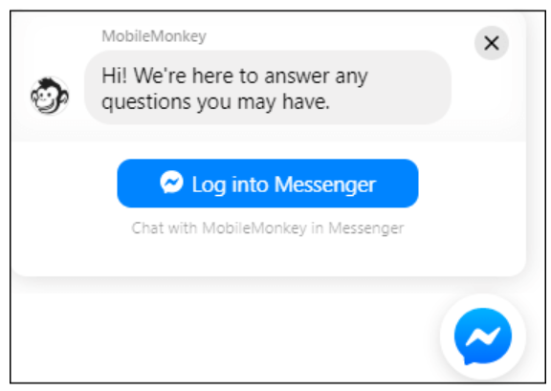
Applications of NLP…
6. Speech Recognition
Speech recognition is used for converting spoken words into text. It is used in applications, such as mobile, home automation, video recovery, dictating to Microsoft Word, voice biometrics, voice user interface, and so on.
7. Chatbot
Implementing the Chatbot is one of the important applications of NLP. It is used by many companies to provide the customer's chat services.

Slide 13
Applications of NLP…
8. Information extraction
Information extraction is one of the most important applications of NLP. It is used for extracting structured information from unstructured or semi-structured machine-readable documents.
9. Natural Language Understanding (NLU)
It converts a large set of text into more formal representations such as first-order logic structures that are easier for the computer programs to manipulate notations of the natural language processing.

Slide 14
How to build an NLP pipeline?
Step1: Sentence Segmentation
Sentence Segment is the first step for building the NLP pipeline. It breaks the paragraph into separate sentences.
Example: Consider the following paragraph -
“Independence Day is one of the important festivals for every Indian citizen. It is celebrated on the 15th of August each year ever since India got independence from the British rule. The day celebrates independence in the true sense.”
Sentence Segment produces the following result:
"Independence Day is one of the important festivals for every Indian citizen."
"It is celebrated on the 15th of August each year ever since India got independence from the British rule."
"This day celebrates independence in the true sense."

Slide 15
How to build an NLP pipeline?...
Step2: Word Tokenization
Word Tokenizer is used to break the sentence into separate words or tokens.
Example:
XYZ offers Corporate Training, Summer Training, Online Training, and Winter Training.
Word Tokenizer generates the following result:
“XYZ", "offers", "Corporate", "Training", "Summer", "Training", "Online", "Training", "and", "Winter", "Training", "."

Slide 16
How to build an NLP pipeline?...
Step3: Stemming
Stemming is used to normalize words into its base form or root form. For example, celebrates, celebrated and celebrating, all these words are originated with a single root word "celebrate." The big problem with stemming is that sometimes it produces the root word which may not have any meaning.
For Example, intelligence, intelligent, and intelligently, all these words are originated with a single root word "intelligen." In English, the word "intelligen" do not have any meaning.

Slide 17
How to build an NLP pipeline?...
Step 4: Lemmatization
Lemmatization is quite similar to the Stamming. It is used to group different inflected forms of the word, called Lemma. The main difference between Stemming and lemmatization is that it produces the root word, which has a meaning.
For example: In lemmatization, the words intelligence, intelligent, and intelligently has a root word intelligent, which has a meaning.

Slide 18
How to build an NLP pipeline?...
Step 5: Identifying Stop Words
In English, there are a lot of words that appear very frequently like "is", "and", "the", and "a". NLP pipelines will flag these words as stop words. Stop words might be filtered out before doing any statistical analysis.
Example: He is a good boy.

Slide 19
How to build an NLP pipeline?...
Step 6: Dependency Parsing
Dependency Parsing is used to find that how all the words in the sentence are related to each other.
Step 7: POS tags
POS stands for parts of speech, which includes Noun, verb, adverb, and Adjective. It indicates that how a word functions with its meaning as well as grammatically within the sentences. A word has one or more parts of speech based on the context in which it is used.
Example: "Google" something on the Internet.
In the above example, Google is used as a verb, although it is a proper noun.

Slide 20
How to build an NLP pipeline?...
Step 8: Named Entity Recognition (NER)
Named Entity Recognition (NER) is the process of detecting the named entity such as person name, movie name, organization name, or location.
Example: Steve Jobs introduced iPhone at the Macworld Conference in San Francisco, California.
Step 9: Chunking
Chunking is used to collect the individual piece of information and grouping them into bigger pieces of sentences.

Slide 21
Phases of NLP
Phonetics and Phonology
Speech Sounds
Phonemes
Morphology
Word Structure
Morphemes
Lexical Analysis
Tokenization
POS tagging
NER
Discourse
Anaphora Resolution
Coherence
Discourse Parsing
Pragmatics
Context
Speech Acts
Implicature
Semantic Analysis
Word Sense
Thematic Roles
Semantic Parsing
Syntactic Analysis
Parsing
Syntax Trees
Figure: Phases of NLP

Slide 22
Phases of NLP…
1. Phonetics and Phonology
Phonetics: Studies the physical production of speech sounds by the human vocal tract. It focuses on how sounds are articulated (e.g., tongue placement, lip movement).
Example: Recognizing the difference between the sounds "p" and "b."
Phonology: Analyzes the sound system of a language. It focuses on how sounds are organized and function within a language (e.g., identifying phonemes, the smallest units of sound that distinguish words).
Example: Recognizing that "p" and "b" are distinct phonemes in English because they can change word meaning (pat vs. bat).

Slide 23
Phases of NLP…
2. Morphology : The study of the structure and formation of words.
Morphemes: The smallest units of meaning in a language.
Free Morphemes: Can stand alone as words (e.g., "book", "cycle").
Bound Morphemes: Cannot stand alone and must be attached to other morphemes (e.g., prefixes like "un-", suffixes like "-ed").
Types of Morphological Processes:
Inflection: Changing a word to express different grammatical categories (e.g., tense, number, case).
Derivation: Creating new words by adding prefixes or suffixes (e.g., "happy" -> "unhappy").
Compounding: Combining two or more words to create a new word (e.g., "toothbrush").
Importance in NLP:
Tokenization: Breaking text into words and morphemes.
Stemming and Lemmatization: Reducing words to their base or root form.

Slide 24
Phases of NLP…
3. Lexical Analysis: The process of analyzing the structure of words and understanding their meaning within a context.
Tasks:
Tokenization: Splitting text into individual tokens (words or phrases).
Part-of-Speech Tagging: Assigning grammatical categories (e.g., noun, verb, adjective) to each token.
Named Entity Recognition (NER): Identifying and classifying named entities (e.g., people, organizations, locations) in text.
Lexicon: A database of words and their meanings, forms, and usage.
Importance in NLP:
Syntax and Semantics: Providing foundational elements for deeper language processing tasks.

Slide 25
Phases of NLP…
4. Syntactic Analysis: The process of analyzing the structure of sentences according to the rules of grammar.
Tasks:
Parsing: Analyzing the grammatical structure of a sentence to determine its syntactic structure.
Syntax Trees: Representing the hierarchical structure of sentences (e.g., parse trees).
Key Concepts:
Context-Free Grammar (CFG): A set of recursive rules used to generate patterns of strings.
Dependency Grammar: Focuses on the relationship between words in a sentence.
Importance in NLP:
Grammar Checking: Ensuring syntactic correctness of sentences.
Machine Translation: Structuring sentences correctly in the target language.

Slide 26
Phases of NLP…
5. Semantic Analysis: The process of understanding the meaning of words and sentences.
Tasks:
Word Sense Disambiguation: Determining which sense of a word is used in a given context.
Thematic Roles: Understanding the roles that words play in actions (e.g., agent, object).
Semantic Parsing: Mapping natural language sentences to formal representations of meaning.
Key Concepts:
Lexical Semantics: The meaning of words and the relationships between them (e.g., synonyms, antonyms).
Compositional Semantics: How meanings of individual words combine to form the meaning of sentences.
Importance in NLP:
Information Retrieval: Understanding user queries to retrieve relevant information.
Question Answering: Interpreting questions and generating accurate answers.

Slide 27
Phases of NLP…
6. Pragmatics: The study of how context influences the interpretation of meaning.
Tasks:
Deixis: Understanding references that depend on context (e.g., "this", "that", "here", "there").
Speech Acts: Analyzing what speakers intend to accomplish with their utterances (e.g., requests, promises, commands).
Conversational Implicature: Understanding implied meanings that are not explicitly stated.
Importance in NLP:
Dialogue Systems: Managing context and maintaining coherent conversations.
Sentiment Analysis: Interpreting the speaker's attitude or emotions.
Notes:
Deixis: Indexicality, Context-dependency, Referentiality, Pronominal reference
Person Deixis: Refers to participants in the conversation.
Examples:
First Person: "I," "we" (e.g., "I am speaking.")
Second Person: "you" (e.g., "You are listening.")
Third Person: "he," "she," "they" (e.g., "She is coming.")
Place Deixis: Refers to spatial locations.
Examples:
"here": Refers to the location of the speaker (e.g., "I am here.")
"there": Refers to a location away from the speaker (e.g., "The book is there.")
Time Deixis: Refers to temporal points or periods.
Examples:
"now": Refers to the current time (e.g., "We need to leave now.")
"then": Refers to a specific time in the past or future (e.g., "We will meet then.")
Discourse Deixis: Refers to parts of the discourse.
Examples: this. that
Social Deixis: Refers to social aspects, such as formality and politeness.
Examples:
Titles: "Mr.," "Mrs.," "Dr." (e.g., "Dr. Smith will see you now.")
Honorifics: "sir," "madam" (e.g., "Thank you, sir.")

Slide 28
Phases of NLP…
7. Discourse: The study of how sentences are structured to form coherent and meaningful texts or dialogues.
Tasks:
Anaphora Resolution: Identifying what pronouns and other referring expressions refer to (e.g., "he", "she", "it").
Coherence and Cohesion: Ensuring logical flow and connectivity between sentences.
Discourse Parsing: Analyzing the structure and elements of a larger text or dialogue.
Key Concepts:
Discourse Markers: Words or phrases that organize and manage the flow of discourse (e.g., "however", "therefore").
Topic Segmentation: Dividing text into segments based on topic shifts.
Importance in NLP:
Text Summarization: Producing concise summaries of longer texts.
Document Understanding: Comprehending and generating coherent multi-sentence texts.

Slide 29
Biology of Speech Processing
Speech Production: Respiratory System: The lungs provide the airflow necessary for speech.
Phonatory System: The vocal cords (or vocal folds) vibrate to create sound waves when air passes through them.
Articulatory System: The tongue, lips, teeth, palate, and other parts of the mouth shape these sound waves into distinct speech sounds.

Slide 30
Biology of Speech Processing…
Place of Articulation:
The location in the vocal tract where the airflow is constricted or obstructed during the production of a speech sound.
Examples:
Bilabial: Both lips come together (e.g., /p/ as in "pat", /b/ as in "bat").
Labiodental: Lower lip touches the upper teeth (e.g., /f/ as in "fat", /v/ as in "vat").
Dental: Tongue touches the upper teeth (e.g., /θ/ as in "thin", /ð/ as in "this").
Alveolar: Tongue touches the alveolar ridge just behind the upper front teeth (e.g., /t/ as in "tap", /d/ as in "dap").
Palatal: Tongue touches the hard palate (e.g., /ʃ/ as in "she", /ʒ/ as in "measure").
Velar: Back of the tongue touches the soft palate or velum (e.g., /k/ as in "cat", /g/ as in "go").
Glottal: Sound is produced at the glottis (e.g., /h/ as in "hat").

Slide 31
Biology of Speech Processing…
Manner of Articulation:
The way in which the airflow is modified as it passes through the vocal tract.
Examples:
Stops: Complete closure of the vocal tract followed by a release (e.g., /p/, /t/, /k/).
Fricatives: Narrowing of the vocal tract causing turbulent airflow (e.g., /f/, /s/, /ʃ/).
Affricates: Combination of a stop and a fricative (e.g., /tʃ/ as in "chop", /dʒ/ as in "job").
Nasals: Airflow through the nose (e.g., /m/, /n/, /ŋ/ as in "sing").
Liquids: Air flows around the sides of the tongue (e.g., /l/ as in "lip", /r/ as in "rip").
Glides: Gliding motion of the tongue (e.g., /j/ as in "yes", /w/ as in "wet").

Slide 32
Word Boundary Detection
Word Boundary Detection: Languages like English have spaces to mark word boundaries, but spoken language and many Indian languages do not have clear word delimiters. Word boundary detection identifies the beginning and end of words in continuous text or speech. Techniques: Acoustic models to detect pauses in speech Statistical models to predict likely word combinations Applications: Speech-to-text systems, OCR, text segmentation Example: In speech, 'I scream' and 'ice cream' may sound similar, and boundary detection resolves ambiguity.

Slide 33
Word Boundary Detection
Identifying the beginning and end of words in a continuous stream of speech or text is a crucial task in NLP and speech processing.
Challenges:
Continuous Speech: In natural speech, there are often no clear pauses between words, making it hard to distinguish word boundaries.
Homophones: Words that sound the same but have different meanings and spellings (e.g., "night" and "knight") add complexity.
Variability: Different speakers, accents, and speaking rates can alter the way word boundaries appear.

Slide 34
Word Boundary Detection…
Techniques:
Acoustic Cues: Utilizing changes in pitch, duration, and intensity of the speech signal to infer word boundaries.
Phonotactic Rules: Language-specific rules about which phoneme sequences are permissible can help identify boundaries.
Statistical Methods: Probabilistic models like Hidden Markov Models (HMMs) or neural networks can predict word boundaries based on learned patterns.
Lexical Information: Using dictionaries and known word lists to match spoken segments to possible words.

Slide 35
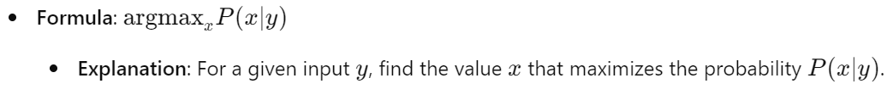
Argmax Based Computations
Definition: The argmax function returns the argument (input) that maximizes a given function. It's widely used in NLP for making decisions based on probabilistic models.
Example:
Steps:
Define the Probability Function: Based on a model or data, such as a probabilistic grammar or a trained neural network.
Evaluate All Possible Inputs: Calculate the probability for each possible x.
Select the Maximum: Choose the x with the highest probability.

Slide 36
HMM and Speech Recognition
Definition: Hidden Markov Models (HMMs) are statistical models used to represent time-series data like speech. Each state in an HMM represents a phoneme or word and transitions between states are governed by probabilities.
Components:
States: Represent different parts of the speech signal, such as different phonemes or words.
Observations: The actual speech sounds (acoustic signals) that are heard.
Transition Probabilities: The probabilities of moving from one state to another.
Emission Probabilities: The probabilities of producing a particular observation from a state.

Slide 37
HMM and Speech Recognition…
Speech Recognition:
Definition: The process of converting spoken language into text.
Process:
Feature Extraction: Convert the speech signal into a sequence of feature vectors that represent the important characteristics of the sound.
Modeling: Use HMM to model the sequence of feature vectors as a sequence of states.
Decoding: Find the most likely sequence of words given the observed feature vectors using algorithms like the Viterbi algorithm.

Slide 38
HMM and Speech Recognition…
Example:
Training: Train the HMM on a labeled dataset of speech and corresponding text. This involves estimating the transition and emission probabilities from the data.
Recognition: Use the trained HMM to recognize new speech input. Given a new sequence of feature vectors, the HMM finds the most probable sequence of states (words) that could have generated the observed sequence.

Slide 39
HMM and Speech Recognition…
Use Case in NLP: Part-of-Speech Tagging Named Entity Recognition Speech Recognition Example: Given a sequence of words, we use argmax to choose the most probable tag sequence.

